Slide 1


CS-513 Final Project
IMDB Movie Rating Prediction
Vipulkumar Uplanchwar - 10413509
Vicky Rana - 10416500

Slide 2
IMDB Movie Rating Prediction
Data set : 2016
Introduction
Overview
Story Line (Why, When, Who )
Results and Conclusion

Slide 3
Introduction
IMDB Movie rating predictions
How can we tell the greatness of a movie before it is released in cinema?
This question arises as there is no universal way to claim the goodness of movies. Many people rely on critics to gauge the quality of a film, while others use their instincts. But it takes the time to obtain a reasonable amount of critics review after a movie is released. And human instinct sometimes is unreliable.
Given that thousands of movies were produced each year, is there a better way for us to tell the greatness of movie without relying on critics or our own instincts?
To answer this question, we tried to predict using KNN, CART, Random Forest.

Slide 4
Why Movie Rating Prediction?
It is so hard to find the rating of movie before it is released in the theatres. We are hence predicting Ratings based on different factors such as Actor,Director Facebook likes, Critic Reviews, Budget and Gross money spent on movie, IMDB Score.
5043 movies.
4906 posters.
28 variables -
"movie_title" "color" "num_critic_for_reviews" "movie_facebook_likes" "duration" "director_name" "director_facebook_likes" "actor_3_name" "actor_3_facebook_likes" "actor_2_name" "actor_2_facebook_likes" "actor_1_name" "actor_1_facebook_likes" "gross" "genres" "num_voted_users" "cast_total_facebook_likes" "facenumber_in_poster" "plot_keywords" "movie_imdb_link" "num_user_for_reviews" "language" "country" "content_rating" "budget" "title_year" "imdb_score" "aspect_ratio"

Slide 5
Data set origin
Source :
https://www.kaggle.com/deepmatrix/imdb-5000-movie-dataset
As per the analysis report made on the data set we found that there were:
28 columns and 5043 rows
There were many rows and columns which were irrelevant for our analysis and problem statement. We removed them and cleaned the data set.

Slide 6
Problem Statement
We are predicting the movies ratings :
Before movie’s actual release using the optimal parameters with highest accuracies.

Slide 7
Data set
Cleaning:
From the chunk of data, only the required data was added into the data frame.
Fields | Input
Num_Critic_for_reviews | Review number by critics
Duration | Duration of movie
Gross | Gross Income
Num_Voted_Users | Number of users voted
Cast_Total_Facebook_likes | Likes of Actors on facebook
Num_users_for_reviews | Number of users who reviewed
Movie_facebook_likes | Movies likes over facebook (Social sites)
Title_Year | Release year
Director_facebook_likes | Director likes over the social sites

Slide 8
Cleaning of data
Made a sub-set of required columns.
Deleted the rows – With NA.
Modified the columns:
For example: ratings 1-7 as – Low , ratings 7-10 as – High.
Deleted the rows with irrelevant values like Actor Name, Budget.
Converted the given time into years.
Normalized whole dataset of required columns before applying KNN, CART and Random Forest.
Shuffled the datasets for better performance of model.
Converted all possible values to numeric and categorical forms for comparison.

Slide 9
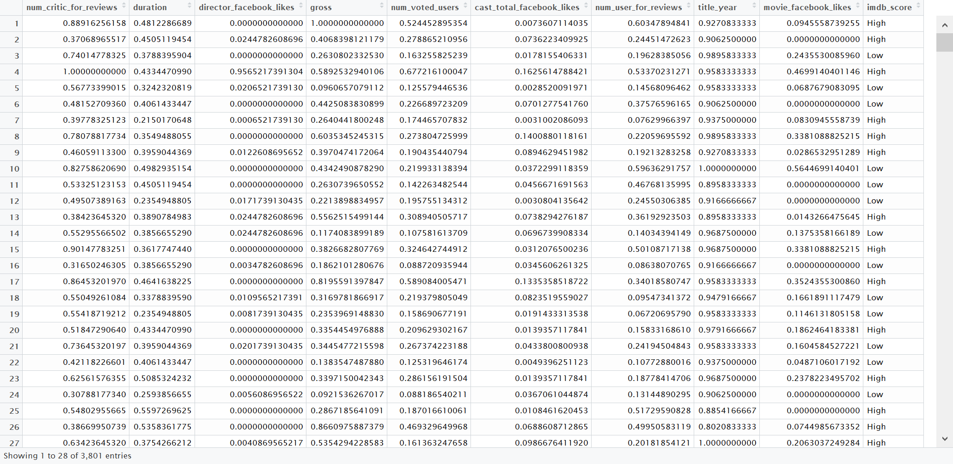
Data after the cleaning process

Slide 10
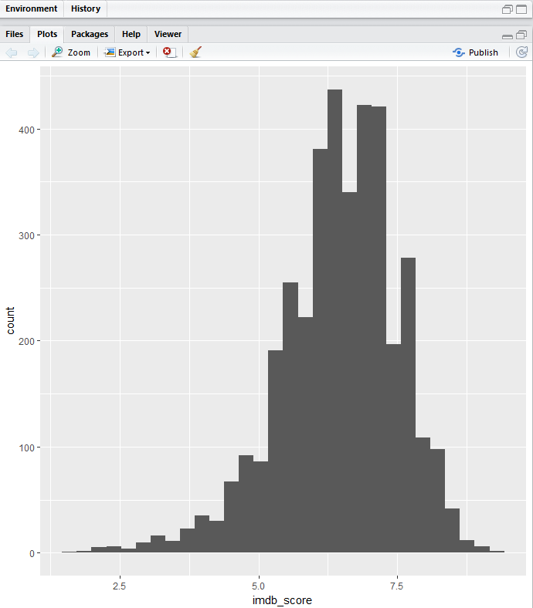
Scatter Plot

Slide 11
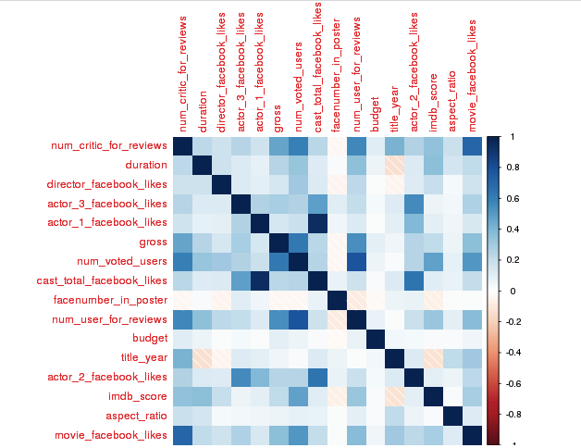
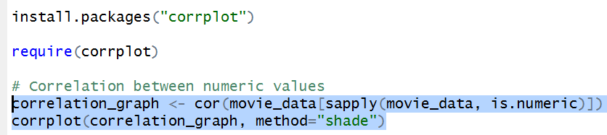
How are deciding variables considered for prediction
After visiting different movie rating web-sites like IMDB, Rotten Tomatoes we came across different variables like “number of users voted”, ”Occasions of movie release”, “Critic review’s” etc.
But it is difficult to judge the exact formula
as these sites don’t reveal them. We have
considered the deciding variables for our
predicting model from the common factors
from these different websites and we
also have created a co-relation matrix
between response and independent
variables.
Code for co-relation matrix -

Slide 12
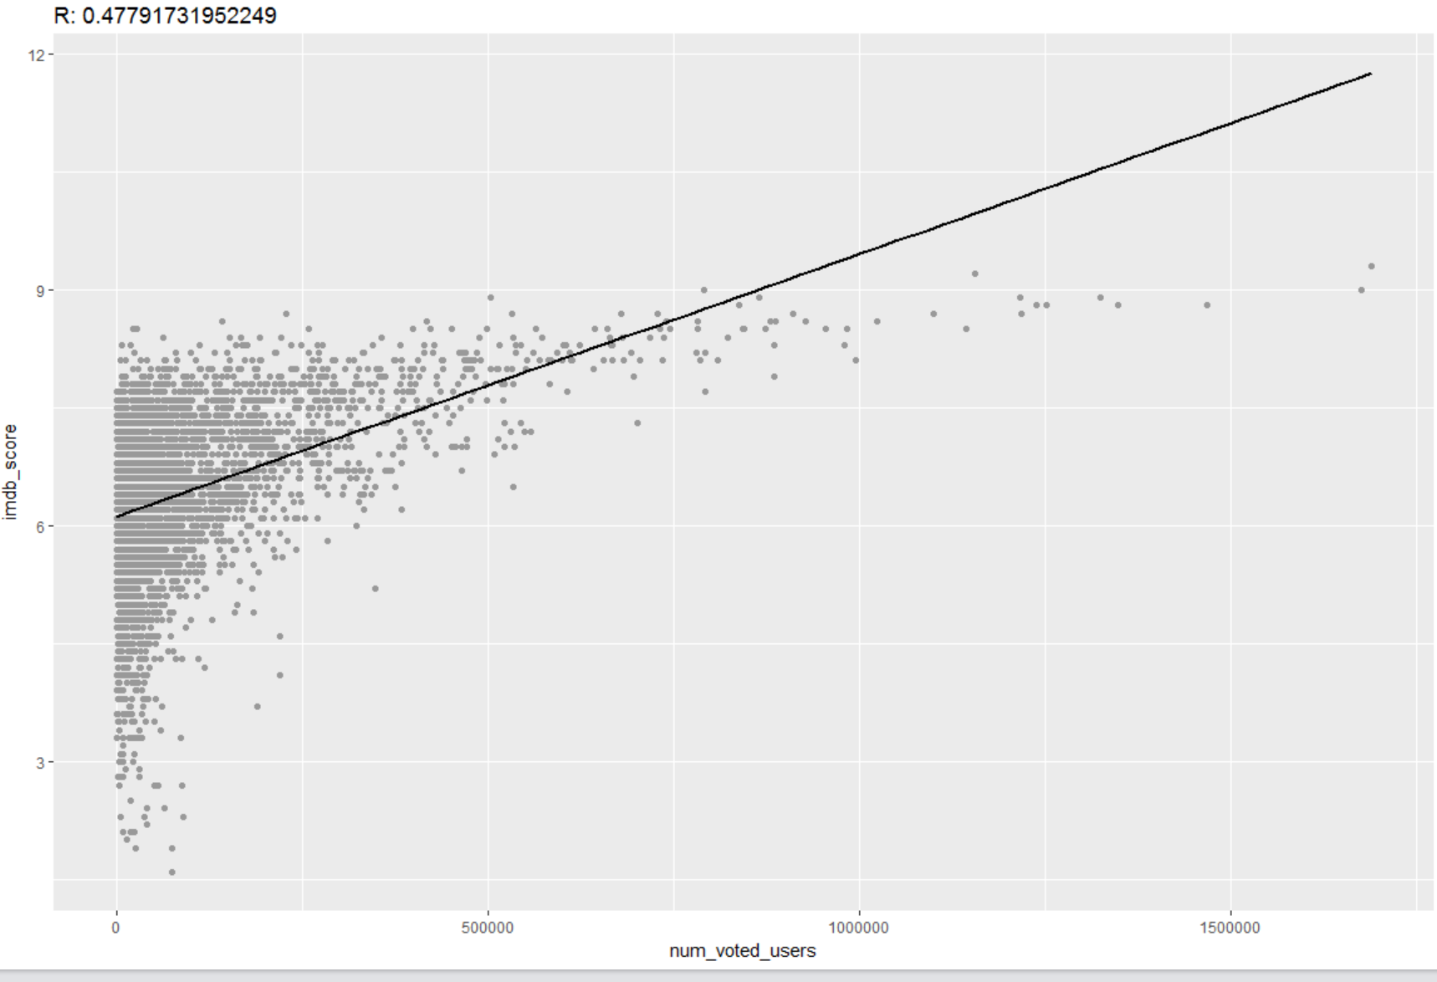
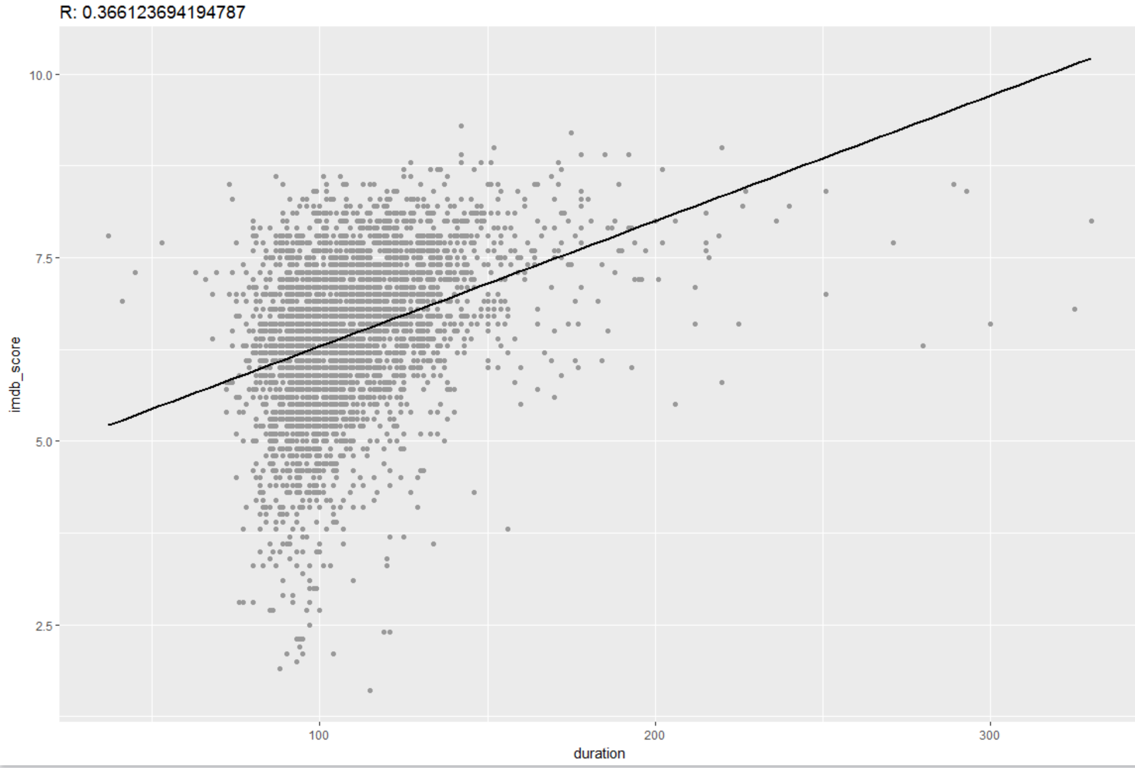
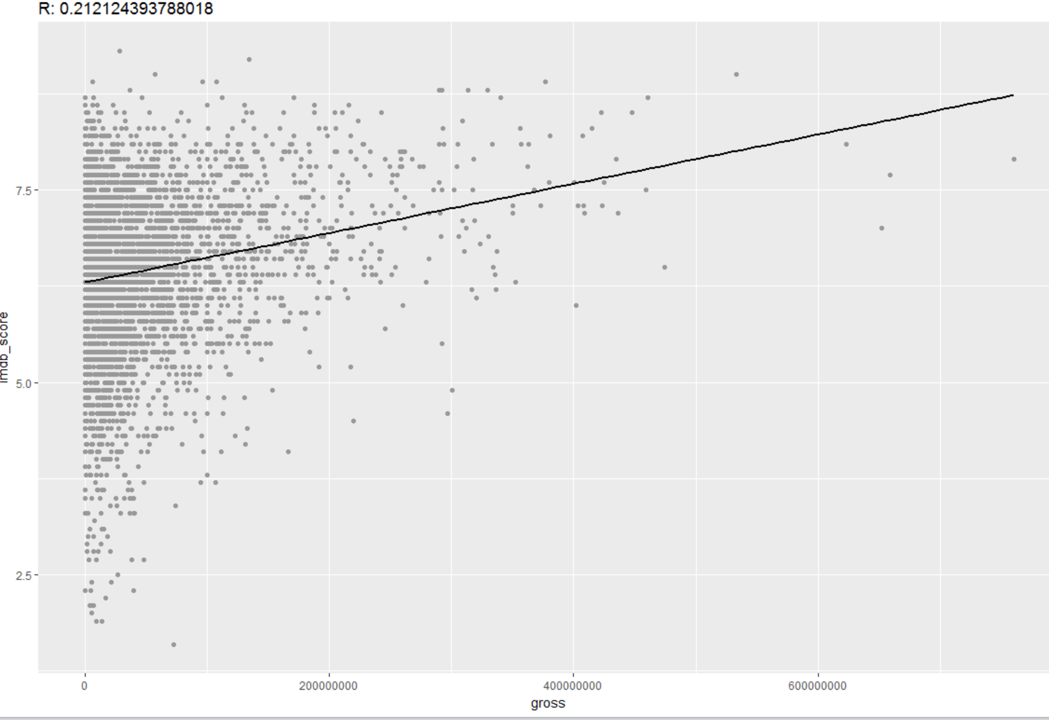
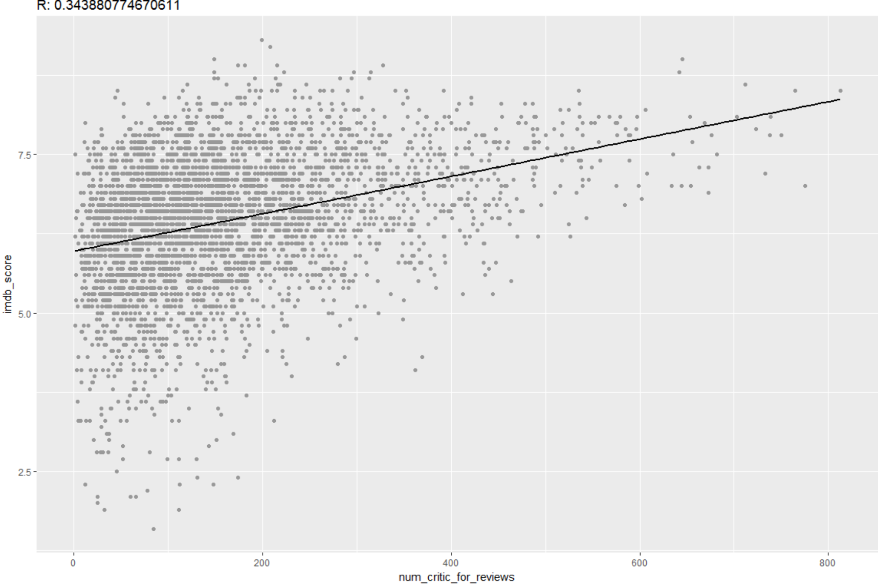
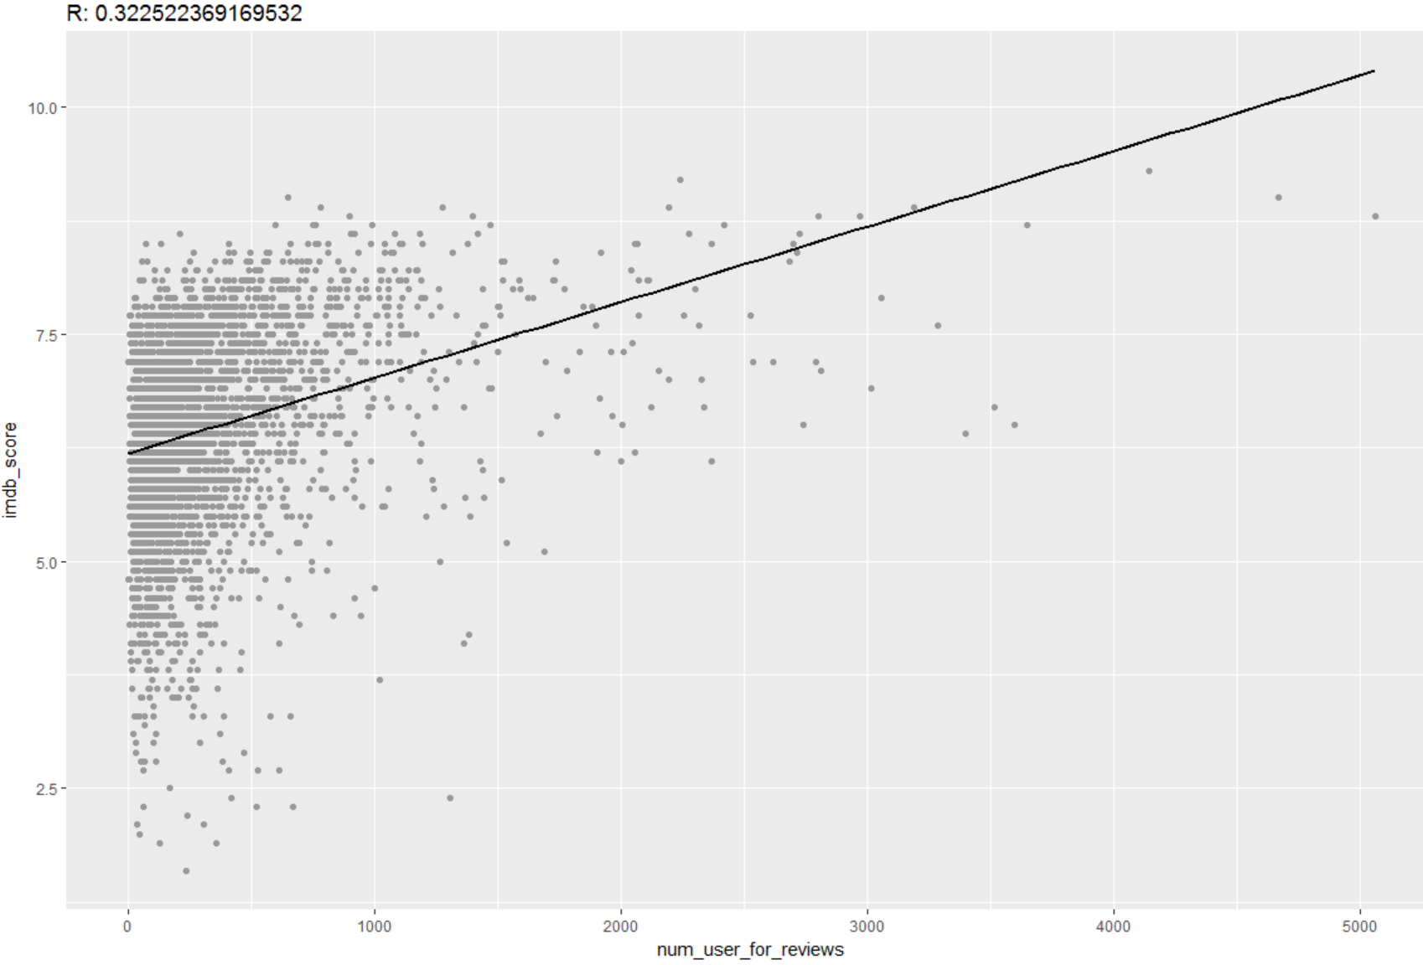
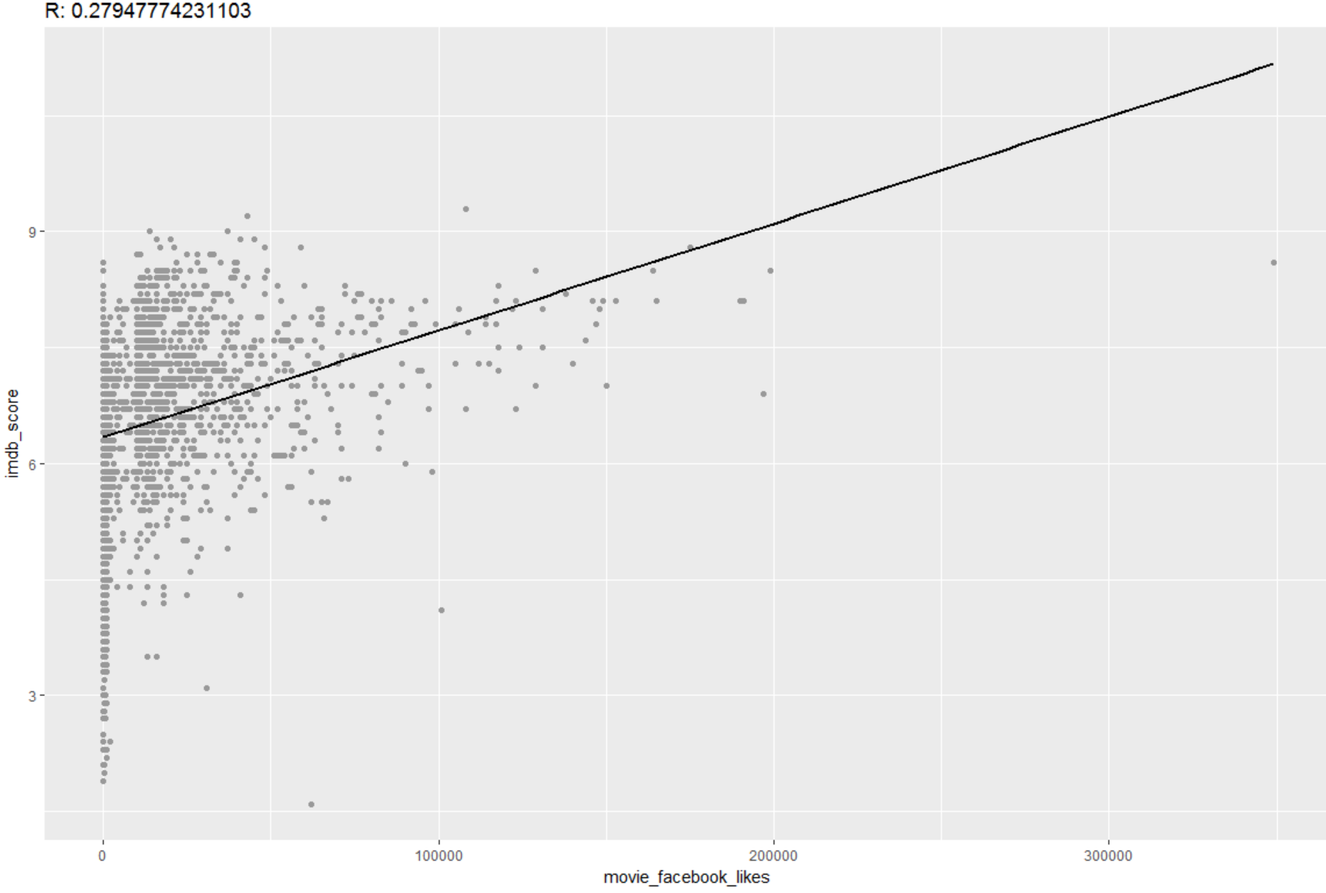
Co-relation scatter graphs.

Slide 13
KNN(K-Nearest Neighbors)
The Algorithm k-Nearest neighbor is an example of instance-based learning, in which the training data set is stored, so that a classification for a new unclassified record may be found simply by comparing it to the most similar records in the training set.
First we tried KNN on all the numeric factors we have in our dataset. We then analysed the accuracy of our model, and took out the unwanted variable which were affecting the prediction accuracy.
We divided our dataset in 20% - Test and 80% - Train data and we applied the KNN algorithm over the training dataset and tested the model on our test Dataset.
Afterwords using the confusion matrix we compared the actual values with predicted values.

Slide 14
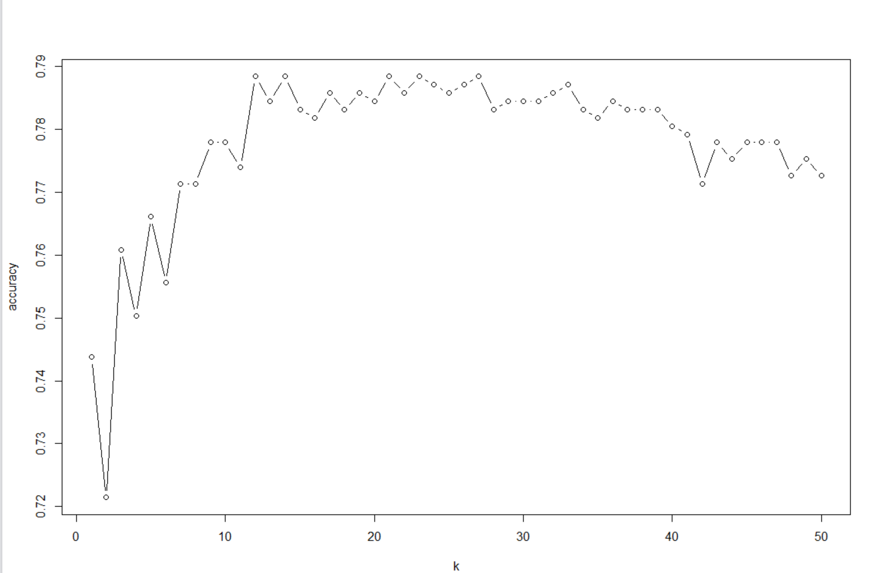
KNN (Continued)
We started with different values of K for prediction starting with K=5 and increasing thereafter. With K=5 we got an accuracy of 76.47% and misclassification rate of 23.52%
To increase the prediction accuracy rate we tried different values and found highest accuracy for K=16 as 78.71% and misclassification rate of 21.28%, which is shown in below graph,

Slide 15
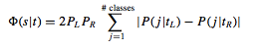
Classification and Regression Trees(CART)
CART -
Decision trees produced by CART are strictly binary, containing exactly two branches for each decision node.
The CART algorithm grows the tree by conducting for each decision node, an exhaustive search of all available variables and all possible splitting values, selecting the optimal split according to the following criteria.
For Implementing CART in RStudio we are using RPART function.
We divided our dataset in 20% - Test and 80% - Train data and we applied the CART algorithm over the training dataset and tested the model on our test Dataset.

Slide 16
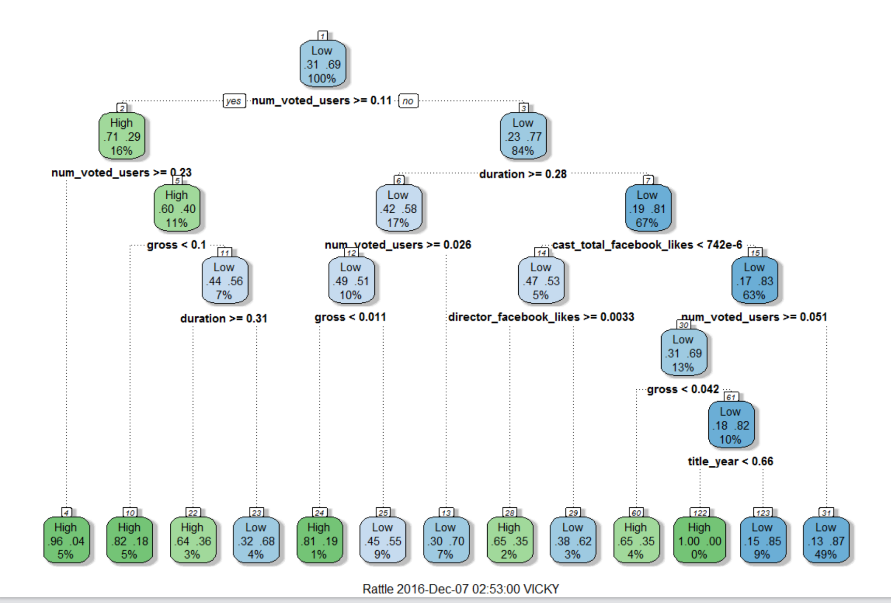
CART(Continued)
Below is the decision tree after applying the model on our training dataset,

Slide 17
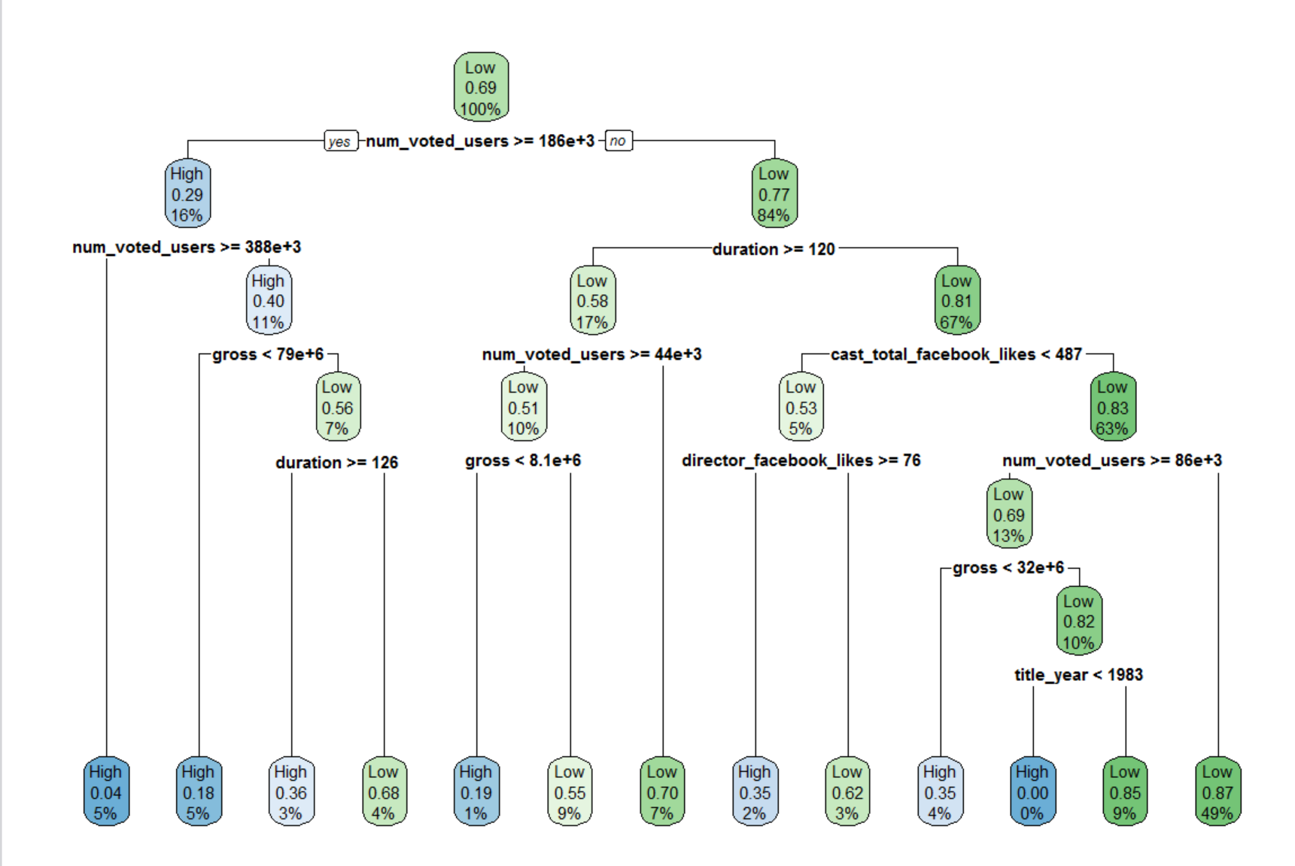

Slide 18
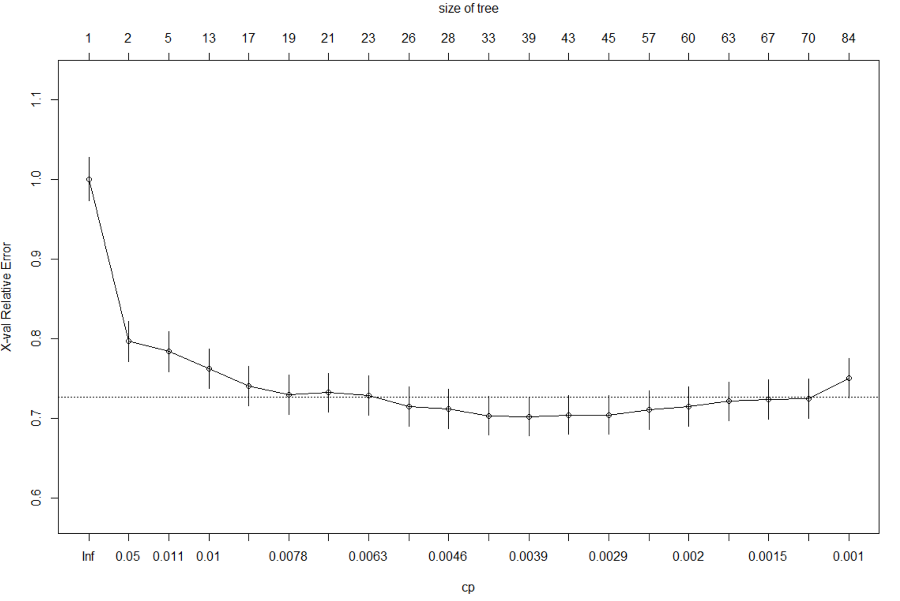
CART(Continued)
After testing the model on our test dataset, we compared it with target variable and got accuracy of 77.77% and error rate of 22.22%.
Co-relation between the predicted values and actual values is around 42%.
Pruned the tree to increase the optimality.
Applied rpart with least cp, resulted in accuracy reduction and increase in error rate.

Slide 19
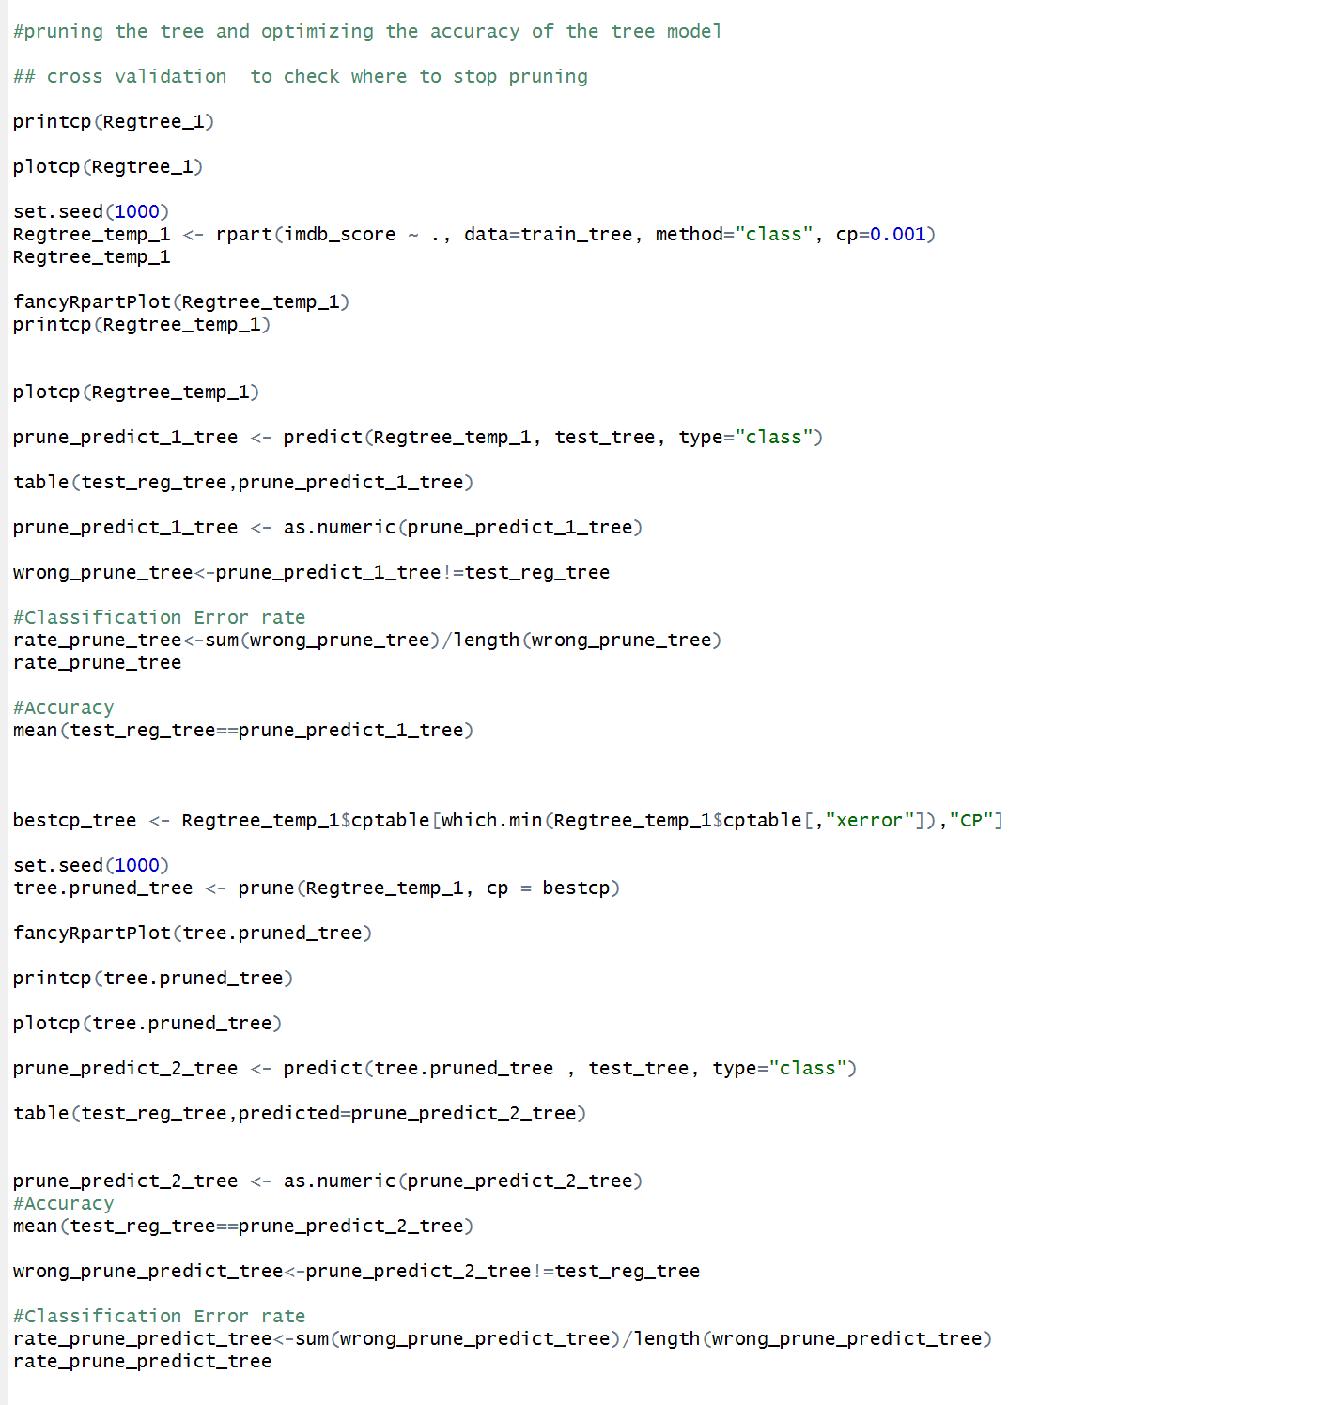

Slide 20
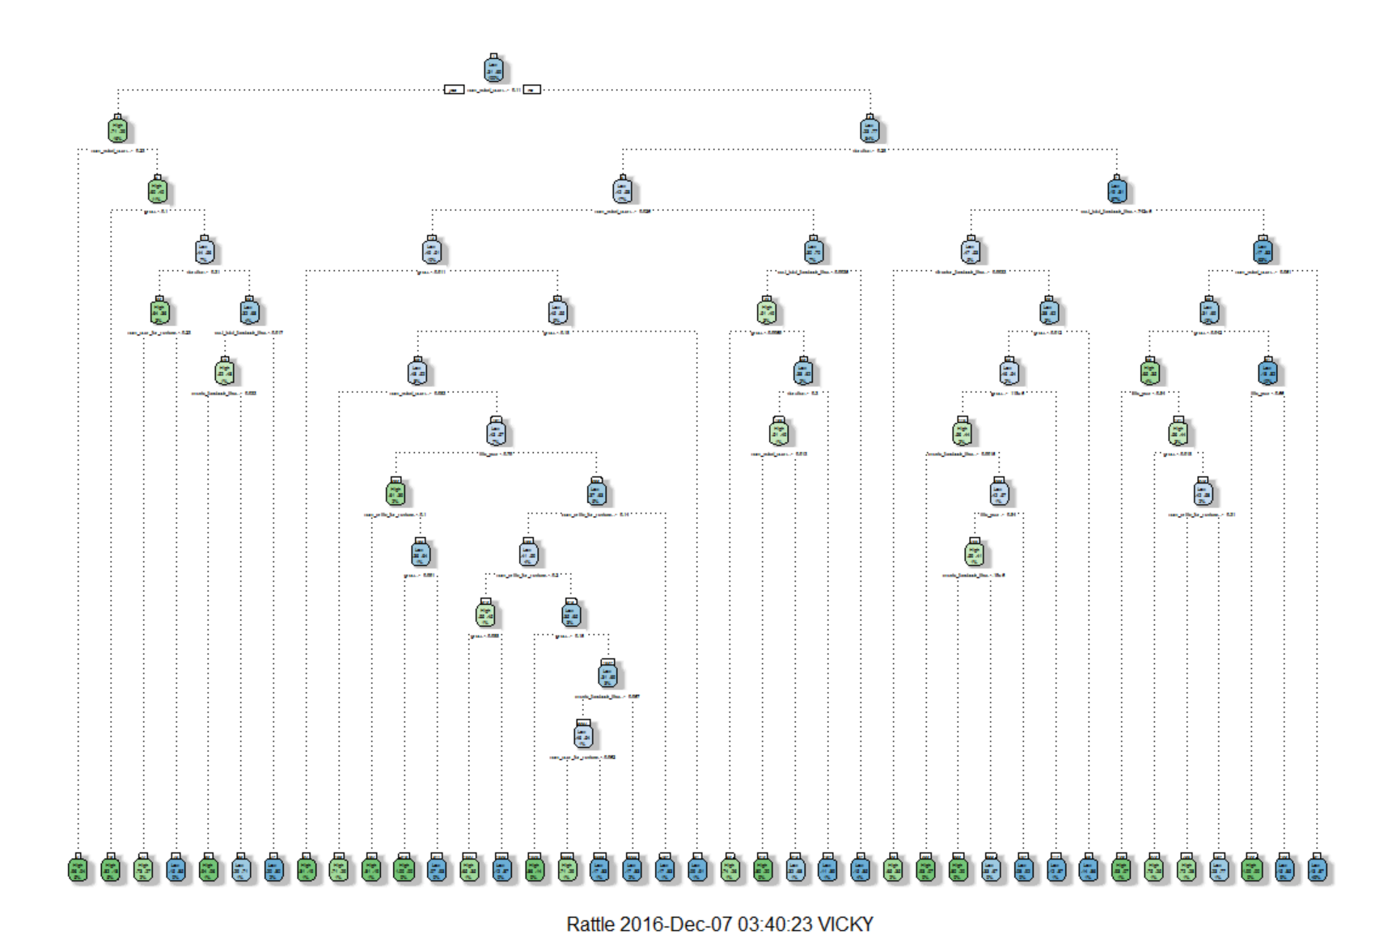
Optimal Decision Tree

Slide 21
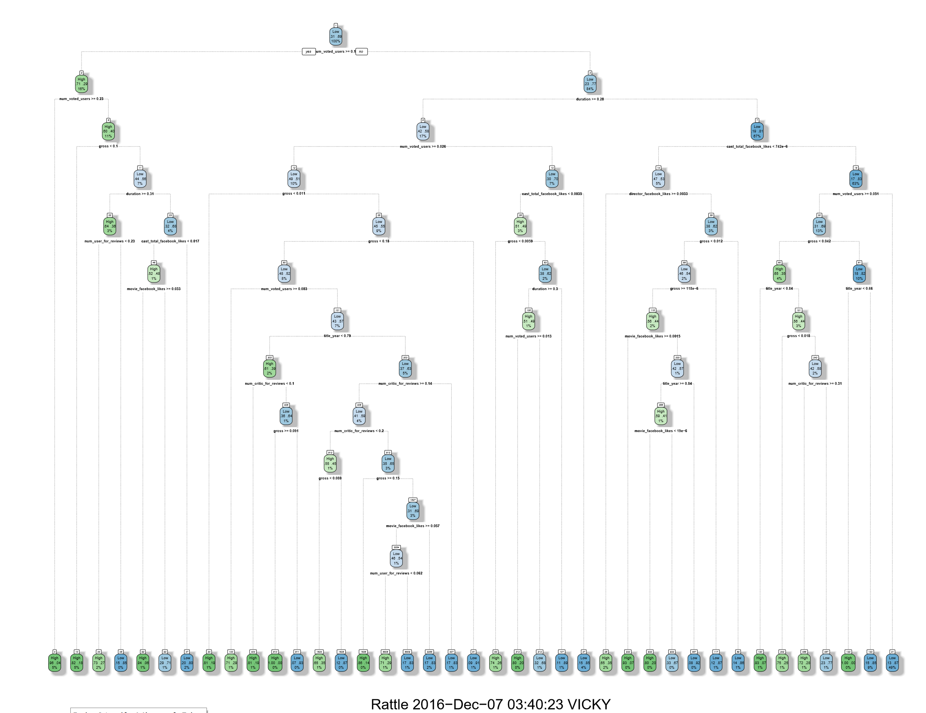

Slide 22
Random Forest
Random forests or random decision forests are an ensemble learning method for classification, regression and other tasks, that operate by constructing a multitude of decision trees at training time and outputting the class that is the mode of the classes (classification) or mean prediction (regression) of the individual trees. Random decision forests correct for decision trees' habit of overfitting to their training set.
For Implementing Random Forest in RStudio we are using randomForest function.
We divided our dataset in 20% - Test and 80% - Train data and we applied the Random Forest algorithm over the training dataset and tested the model on our test Dataset.

Slide 23
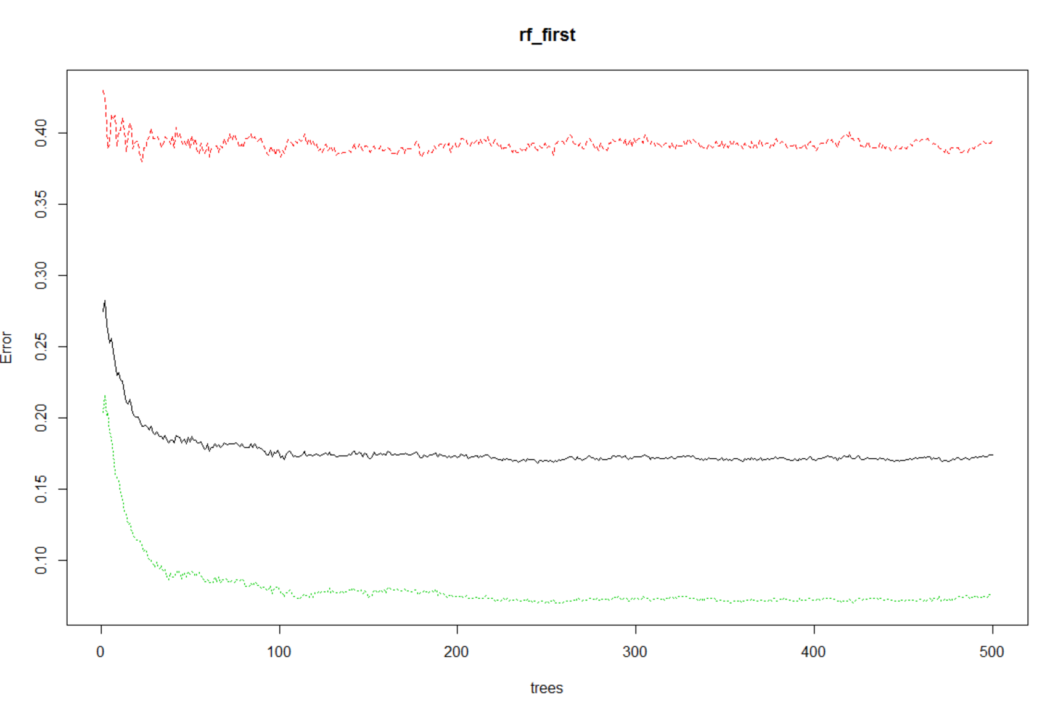
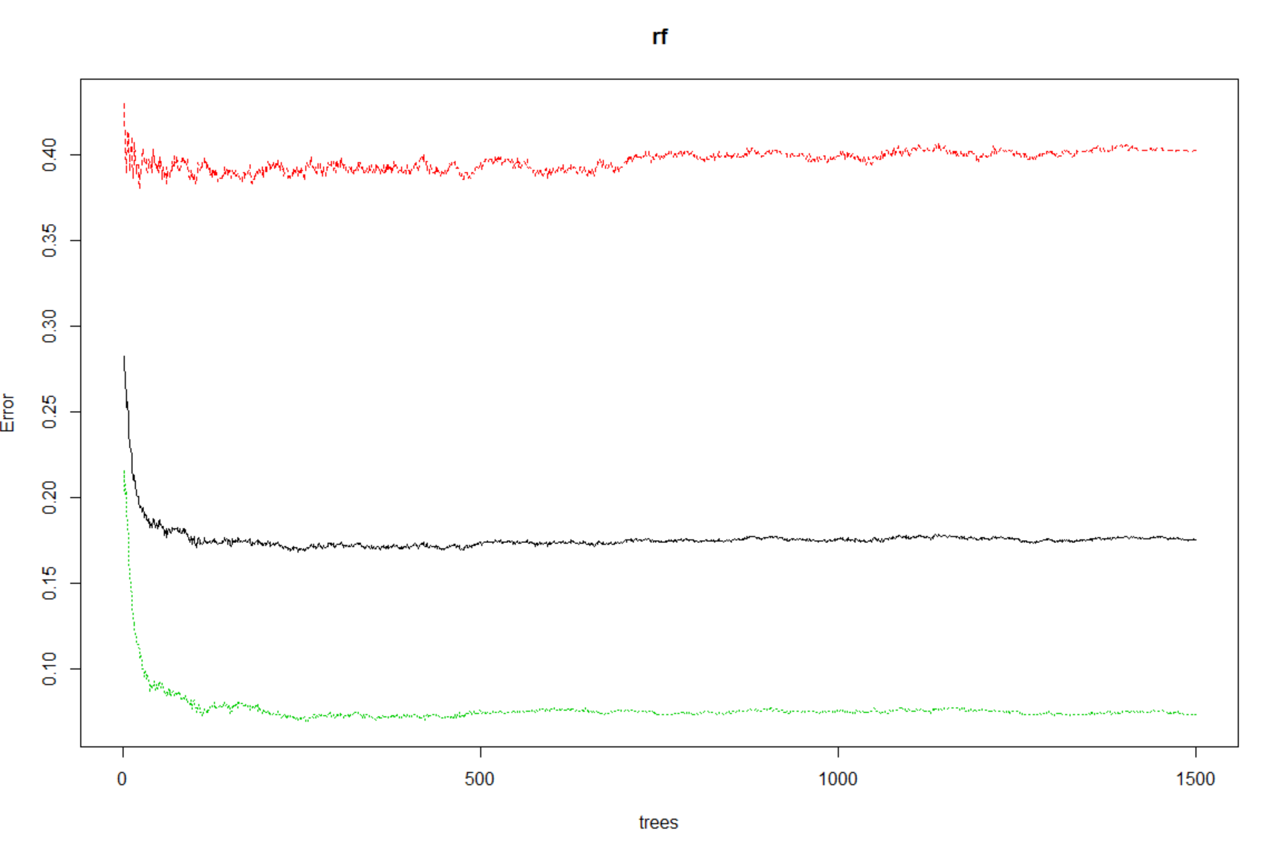
Random Forest plot
Without the ntree parameter
With ntree parameter = 500

Slide 24
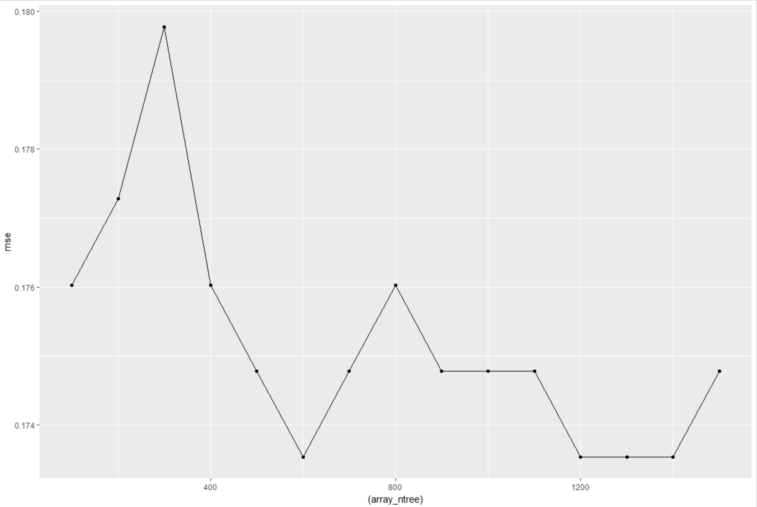
Random Forest (Continued)
After testing the model on our test dataset, we compared it with target variable and got accuracy of 82.52% and error rate of 17.47%.
Co-relation between the predicted values and actual values is around 56.08%
Tuning the n-tree parameter.

Slide 25
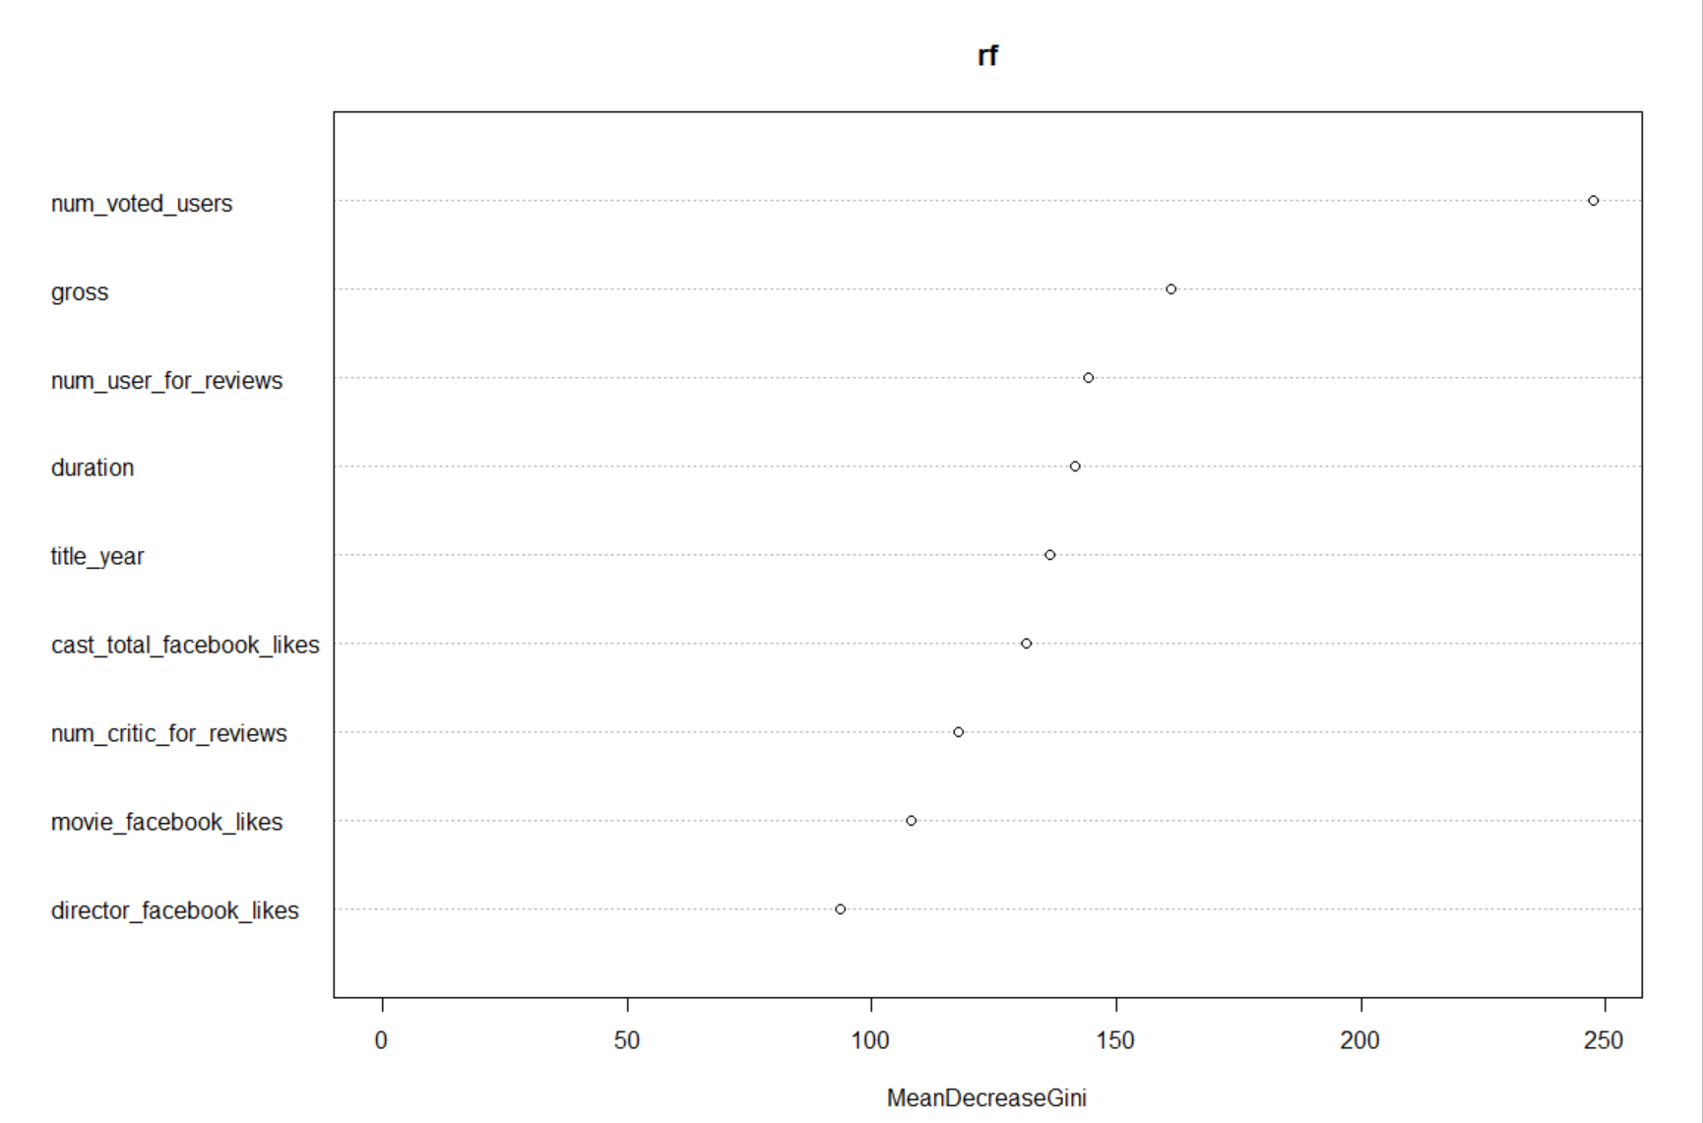
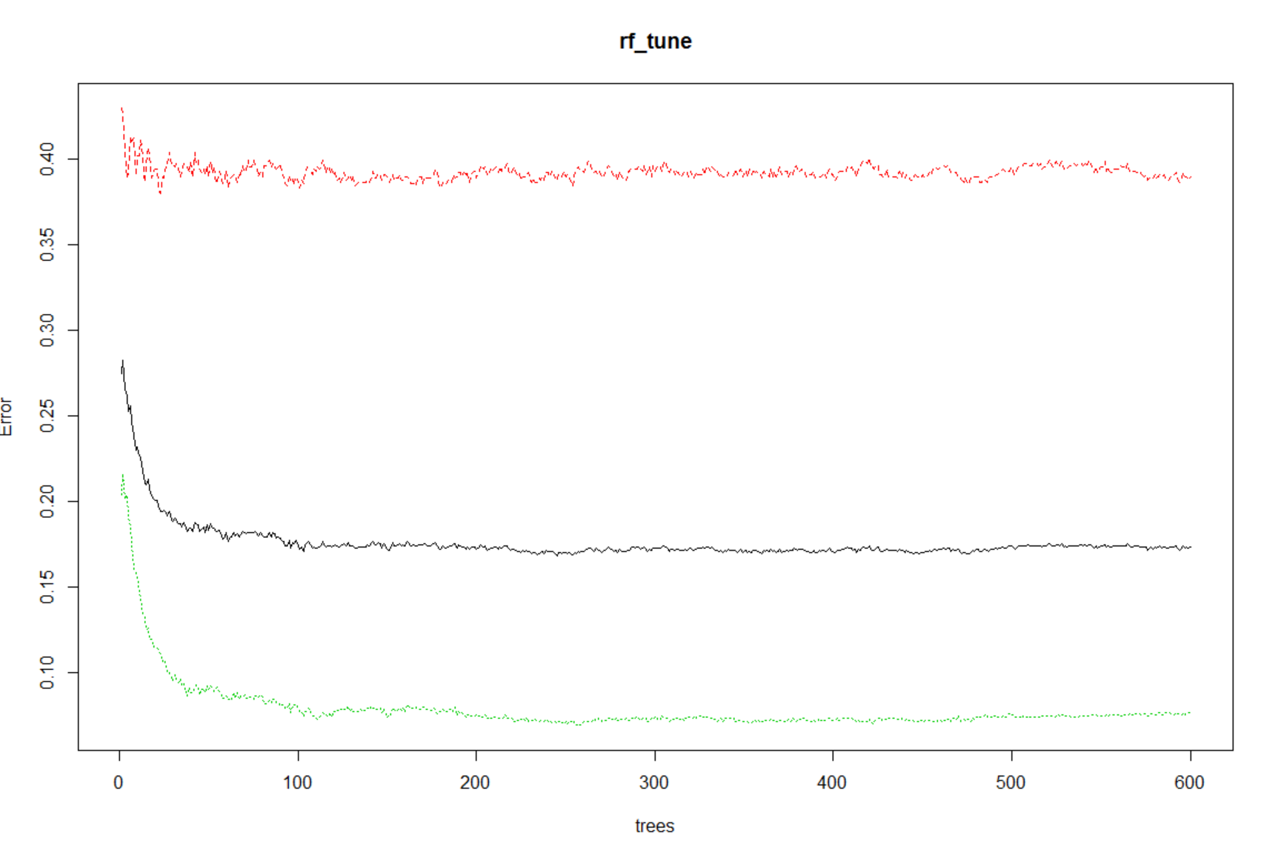
Random Forest (Continued)
After Changing the entry parameter to its optimal value in randomForest function it gained an accuracy of 82.64% and error rate of 17.35%.

Slide 26
Conclusion
Finally we conclude by deducing that Random Forest can predict the highest accuracy on this dataset on the optimal variables considered by highest co-relation values. We can use this predictive model on any new dataset having the same variables for optimal solution.

Slide 27
Future Scope
There can be many ways of representing the data:
We can work more on the accuracy rate of the model.
We can predict movie ratings even deeper based on other factors, example: History of production house having it as a categorical factor.

Slide 28
References
https://www.kaggle.com/deepmatrix/imdb-5000-movie-dataset
http://statweb.stanford.edu/~jtaylo/courses/stats202/ensemble.html
http://www.imdb.com/
https://www.r-bloggers.com/
https://www.youtube.com/watch?v=XLNsl1Da5MA&t=752s
An Introduction to Data mining reference book by Daniel T Larose

Slide 29
Thank you
Any question?

